Slide 1
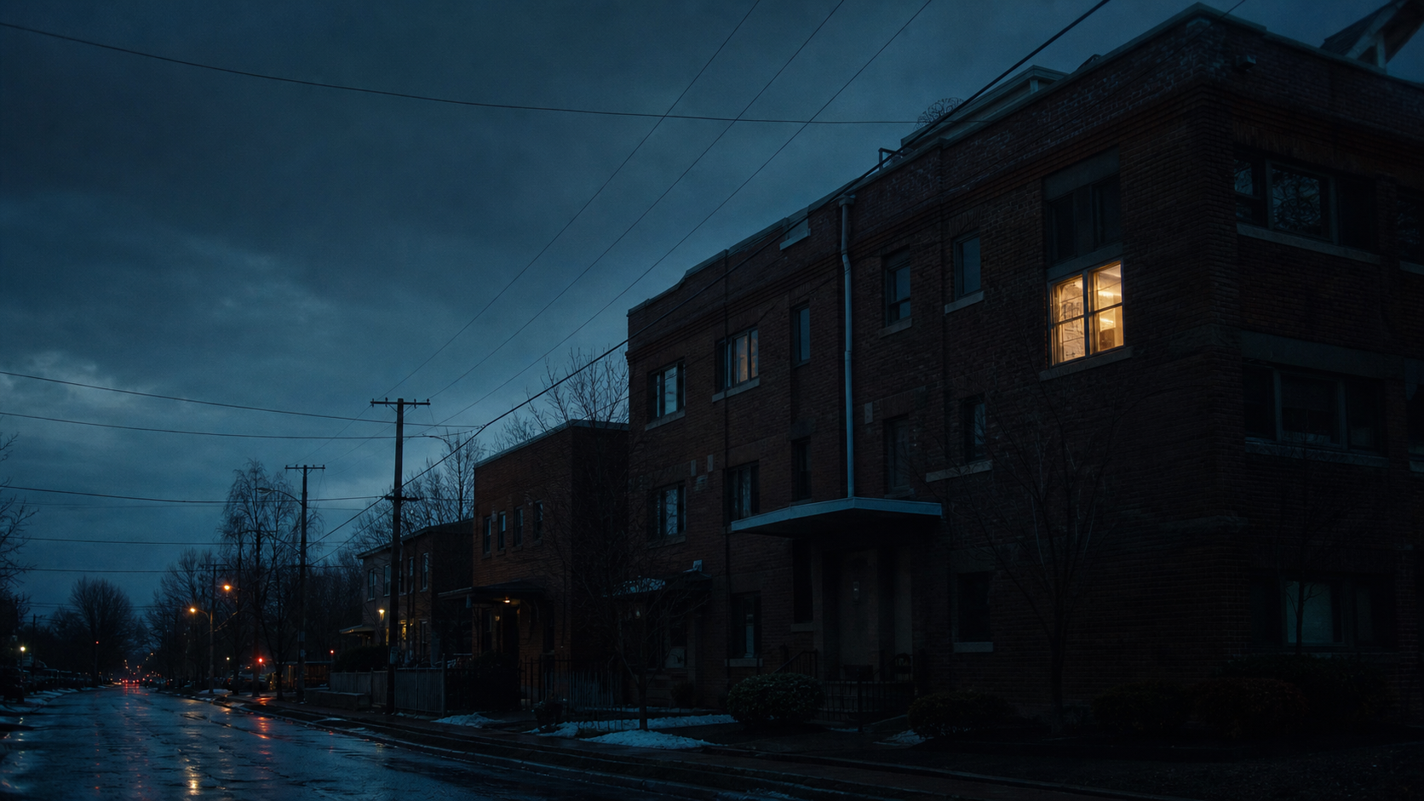
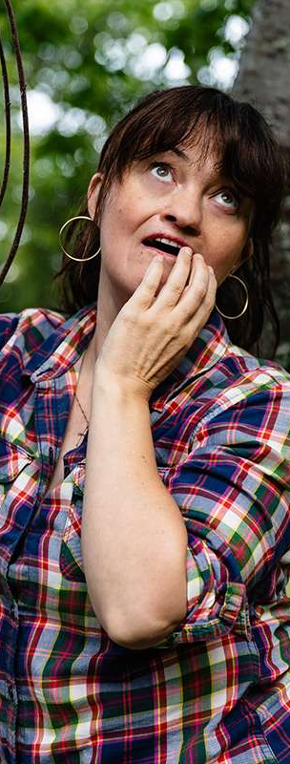
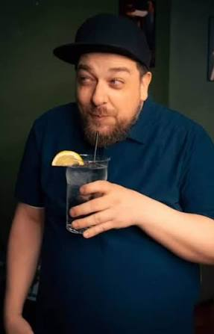
A PRIVATE ENTRY / ORIGINAL COMEDY SERIES
BUNKIES
A promise she can’t break.
A brother she can’t evict.
CREATED BY DAN GALEA & NIKKI PAYNE
TORONTO / COMEDY WITH CONSEQUENCES
NIKKI PAYNE
DAN GALEA
ENTER THE APARTMENT →
Notes:
[Sources]
- Original creative source: Bunkies_Series_Pitch.pdf — https://drive.google.com/file/d/1tnmFUXDbfzZtrP_CZwmBUDGFne3sOrVP/view
- Pilot teleplay: BUNKIES.pdf — https://drive.google.com/file/d/1ar46T1E0PMynXS2NCMS-bK2salT2uSoC/view
- Character portrait: Nikki Payne.jpg, supplied by the user for this deck.
- Character portrait: Dan Galea.jpeg, supplied by the user for this deck.
- Visual: OpenAI-generated Toronto apartment exterior, toronto-exterior.png, created for this deck.
[/Sources]

Slide 2
BUNKIES / PRIVATE ENTRY 02
THE SERIES IN ONE BREATH
Nikki promises her dying roommate she’ll look after his identical twin.
Dan hears a lease.
The face she misses becomes the chaos she can’t escape.
GRIEF
→
OBLIGATION
→
FORCED FAMILY
02
Notes:
[Sources]
- Original creative source: Bunkies_Series_Pitch.pdf — https://drive.google.com/file/d/1tnmFUXDbfzZtrP_CZwmBUDGFne3sOrVP/view
- Pilot teleplay: BUNKIES.pdf — https://drive.google.com/file/d/1ar46T1E0PMynXS2NCMS-bK2salT2uSoC/view
[/Sources]

Slide 3
BUNKIES / PRIVATE ENTRY 03
THE EMOTIONAL PREMISE
The promise is airtight.
The living arrangement is catastrophic.
01
02
03
04
SUNNY DIES
THE LAST ASK
NIKKI SAYS YES
DAN MOVES IN
A freak mudslide takes the saintly twin.
“Take care of my brother.”
Grief removes every escape clause.
Compassion becomes tenancy.
One impossible promise becomes a repeatable comedy engine.
03
Notes:
[Sources]
- Original creative source: Bunkies_Series_Pitch.pdf — https://drive.google.com/file/d/1tnmFUXDbfzZtrP_CZwmBUDGFne3sOrVP/view
- Pilot teleplay: BUNKIES.pdf — https://drive.google.com/file/d/1ar46T1E0PMynXS2NCMS-bK2salT2uSoC/view
[/Sources]

Slide 4
BUNKIES / PRIVATE ENTRY 04
NIKKI
ORDER
Her boundaries are architecture.
DAN
CHAOS
His are light suggestions.
04
Notes:
[Sources]
- Original creative source: Bunkies_Series_Pitch.pdf — https://drive.google.com/file/d/1tnmFUXDbfzZtrP_CZwmBUDGFne3sOrVP/view
- Pilot teleplay: BUNKIES.pdf — https://drive.google.com/file/d/1ar46T1E0PMynXS2NCMS-bK2salT2uSoC/view
- Character portrait: Nikki Payne.jpg, supplied by the user for this deck.
- Character portrait: Dan Galea.jpeg, supplied by the user for this deck.
[/Sources]

Slide 5
BUNKIES / PRIVATE ENTRY 05
NIKKI
PLAYED BY NIKKI PAYNE
She has a system for everything.
Schedules are sacred. Hospitality has rules. Grief is the first thing she can’t organize.
Her promise to Sunny outranks every boundary she built to survive.
“JUST DON’T BE AN ASSHOLE.”
05
Notes:
[Sources]
- Original creative source: Bunkies_Series_Pitch.pdf — https://drive.google.com/file/d/1tnmFUXDbfzZtrP_CZwmBUDGFne3sOrVP/view
- Pilot teleplay: BUNKIES.pdf — https://drive.google.com/file/d/1ar46T1E0PMynXS2NCMS-bK2salT2uSoC/view
- Character portrait: Nikki Payne.jpg, supplied by the user for this deck.
[/Sources]

Slide 6
BUNKIES / PRIVATE ENTRY 06
DAN
PLAYED BY DAN GALEA
The contamination event.
He treats every boundary like a suggestion—then acts wounded when the furniture disagrees.
SHAMELESS / IMPULSIVE / INVENTIVE
Loyal—eventually.
06
Notes:
[Sources]
- Original creative source: Bunkies_Series_Pitch.pdf — https://drive.google.com/file/d/1tnmFUXDbfzZtrP_CZwmBUDGFne3sOrVP/view
- Pilot teleplay: BUNKIES.pdf — https://drive.google.com/file/d/1ar46T1E0PMynXS2NCMS-bK2salT2uSoC/view
- Character portrait: Dan Galea.jpeg, supplied by the user for this deck.
[/Sources]

Slide 7
BUNKIES / PRIVATE ENTRY 07
THE CHEMISTRY
Control meets chaos.
Neither leaves unchanged.
SHE BUILDS RULES
↔
HE FINDS LOOPHOLES
SHE HIDES GRIEF
↔
HE PERFORMS NEED
SHE WANTS CONTROL
↔
HE WANTS BELONGING
ORDER
CHAOS
The fight is funny because the need is real.
07
Notes:
[Sources]
- Original creative source: Bunkies_Series_Pitch.pdf — https://drive.google.com/file/d/1tnmFUXDbfzZtrP_CZwmBUDGFne3sOrVP/view
- Pilot teleplay: BUNKIES.pdf — https://drive.google.com/file/d/1ar46T1E0PMynXS2NCMS-bK2salT2uSoC/view
- Character portrait: Nikki Payne.jpg, supplied by the user for this deck.
- Character portrait: Dan Galea.jpeg, supplied by the user for this deck.
[/Sources]

Slide 8
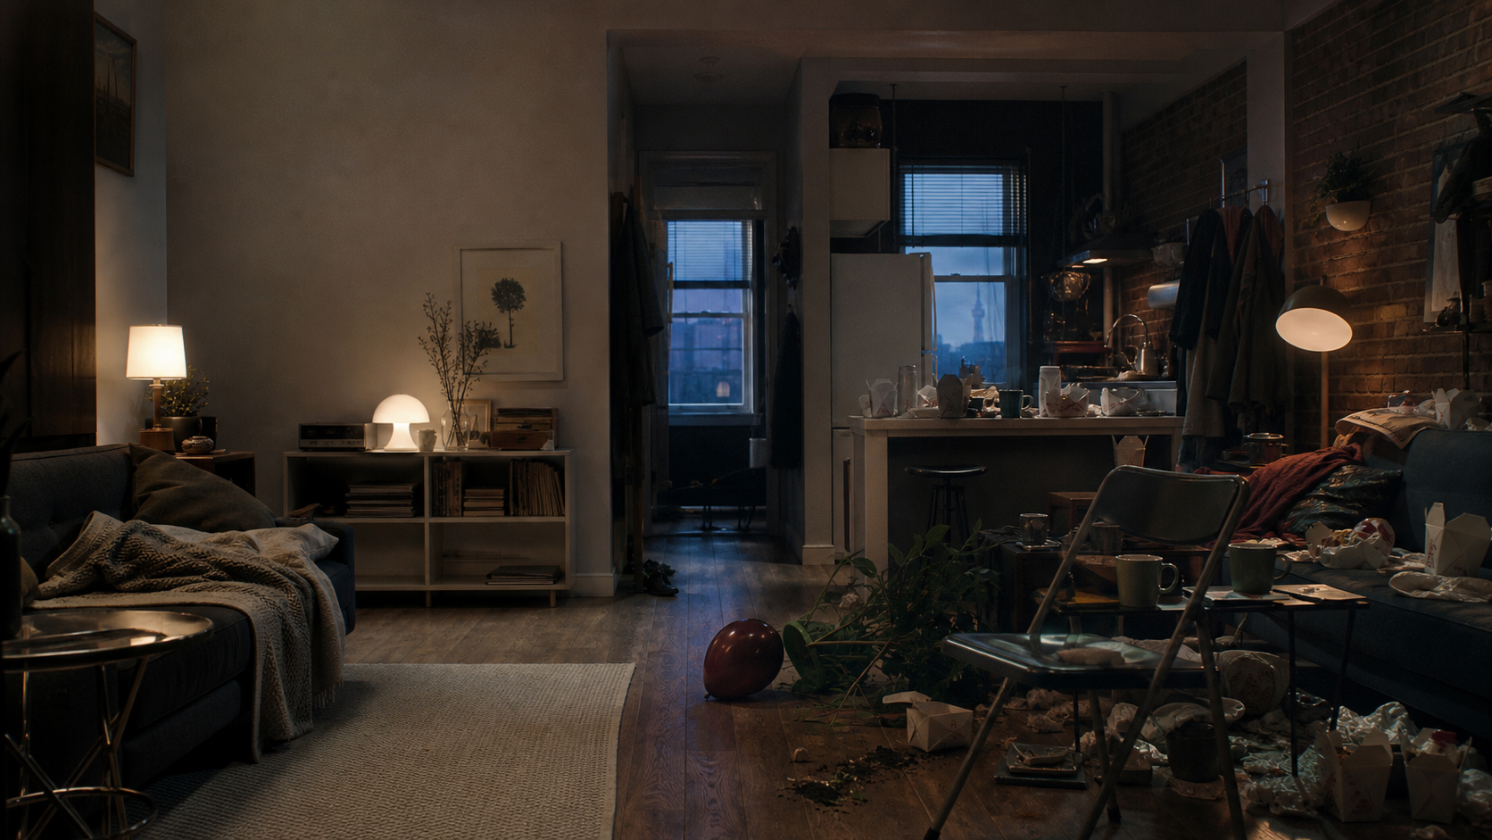
BUNKIES / PRIVATE ENTRY 08
THE WORLD
The apartment is not a backdrop.
It is the battleground.
KITCHEN
Food, smoke and etiquette become chemical weapons.
BEDROOM
Nikki’s refuge becomes Dan’s first claimed territory.
One contained arena. Infinite social damage.
08
Notes:
[Sources]
- Original creative source: Bunkies_Series_Pitch.pdf — https://drive.google.com/file/d/1tnmFUXDbfzZtrP_CZwmBUDGFne3sOrVP/view
- Pilot teleplay: BUNKIES.pdf — https://drive.google.com/file/d/1ar46T1E0PMynXS2NCMS-bK2salT2uSoC/view
- Visual: OpenAI-generated apartment interior, apartment-chaos.png, created for this deck.
[/Sources]

Slide 9
BUNKIES / PRIVATE ENTRY 09
THE SERIES ENGINE
Every episode contaminates
one clean objective.
01
02
03
04
NEED
BOUNDARY
CONTAMINATION
RESCUE
Nikki needs one adult outcome.
She creates a rule to protect it.
Dan ignores or weaponizes it.
His chaos solves the larger problem.
RESET: the apartment survives. The relationship gets harder to undo.
09
Notes:
[Sources]
- Original creative source: Bunkies_Series_Pitch.pdf — https://drive.google.com/file/d/1tnmFUXDbfzZtrP_CZwmBUDGFne3sOrVP/view
- Pilot teleplay: BUNKIES.pdf — https://drive.google.com/file/d/1ar46T1E0PMynXS2NCMS-bK2salT2uSoC/view
[/Sources]

Slide 10
BUNKIES / PRIVATE ENTRY 10
THE PILOT
One catastrophic day proves
the entire engine.
01
PROMISE
Sunny’s last request turns grief into obligation.
28
02
INVASION
Dan moves in before Nikki can redefine ‘help.’
03
EJECTION
Smoke, neighbours and broken rules snap her patience.
PAGES
A hard reset—with one degree more attachment.
04
RESCUE
Dan’s absurd intervention ends a dangerous date.
05
RESET
She offers friendship. He insists on family.
READ THE PILOT →
10
Notes:
[Sources]
- Original creative source: Bunkies_Series_Pitch.pdf — https://drive.google.com/file/d/1tnmFUXDbfzZtrP_CZwmBUDGFne3sOrVP/view
- Pilot teleplay: BUNKIES.pdf — https://drive.google.com/file/d/1ar46T1E0PMynXS2NCMS-bK2salT2uSoC/view
[/Sources]

Slide 11
BUNKIES / PRIVATE ENTRY 11
THE ENSEMBLE
Nobody lowers the temperature.
They add oxygen.
KATE
CLARK
JEFF + TRACY
THE GROUNDING WIRE
THE BIZARRE OUTLIER
THE ESCALATION UNIT
Logic, loyalty—and the occasional terrible idea.
A date so wrong that Dan briefly becomes protection.
Private dysfunction becomes a building-wide crisis.
Every supporting character changes the pressure—not just the punchline.
11
Notes:
[Sources]
- Original creative source: Bunkies_Series_Pitch.pdf — https://drive.google.com/file/d/1tnmFUXDbfzZtrP_CZwmBUDGFne3sOrVP/view
- Pilot teleplay: BUNKIES.pdf — https://drive.google.com/file/d/1ar46T1E0PMynXS2NCMS-bK2salT2uSoC/view
[/Sources]

Slide 12
BUNKIES / PRIVATE ENTRY 12
TONE + FORM
Fast absurdity.
Consequences that stick.
Heart that arrives late.
01
THE JOKE MOVES
A laugh creates a worse practical problem.
02
THE ROOM REMEMBERS
Furniture, neighbours and trust carry damage forward.
03
DIALOGUE IS A WEAPON
The comedy can go too far because the emotional truth stays close.
Nikki argues for reality. Dan rewrites the premise.
SINGLE-CAMERA / PERFORMANCE-LED / CINEMATICALLY CONTAINED
12
Notes:
[Sources]
- Original creative source: Bunkies_Series_Pitch.pdf — https://drive.google.com/file/d/1tnmFUXDbfzZtrP_CZwmBUDGFne3sOrVP/view
- Pilot teleplay: BUNKIES.pdf — https://drive.google.com/file/d/1ar46T1E0PMynXS2NCMS-bK2salT2uSoC/view
[/Sources]

Slide 13
BUNKIES / PRIVATE ENTRY 13
SEASON RUNWAY
The apartment contains the engine.
The world keeps expanding.
01
02
03
04
05
HOME
WORK
DATING
FAMILY
NEIGHBOURS
Domestic rituals become sovereignty fights.
Nikki’s professional order meets Dan’s improvisation.
Romance exposes the difference between safety and control.
Sunny’s absence keeps rewriting both of them.
Private chaos becomes public consequence.
The location stays familiar. The stakes stop being private.
13
Notes:
[Sources]
- Original creative source: Bunkies_Series_Pitch.pdf — https://drive.google.com/file/d/1tnmFUXDbfzZtrP_CZwmBUDGFne3sOrVP/view
- Pilot teleplay: BUNKIES.pdf — https://drive.google.com/file/d/1ar46T1E0PMynXS2NCMS-bK2salT2uSoC/view
[/Sources]

Slide 14
BUNKIES / PRIVATE ENTRY 14
THE PRODUCTION CASE
Contained enough to produce.
Expansive enough to return to.
ONE PRIMARY ARENA
A strong, repeatable visual signature.
A/B STORY READY
Two colliding objectives generate intersecting stories.
ENSEMBLE WITH LEVERAGE
Every guest changes the pressure.
TORONTO IN THE DNA
Specific without becoming a postcard.
Production economy without visual smallness.
14
Notes:
[Sources]
- Original creative source: Bunkies_Series_Pitch.pdf — https://drive.google.com/file/d/1tnmFUXDbfzZtrP_CZwmBUDGFne3sOrVP/view
- Pilot teleplay: BUNKIES.pdf — https://drive.google.com/file/d/1ar46T1E0PMynXS2NCMS-bK2salT2uSoC/view
- Visual: OpenAI-generated Toronto apartment exterior, toronto-exterior.png, created for this deck.
[/Sources]

Slide 15
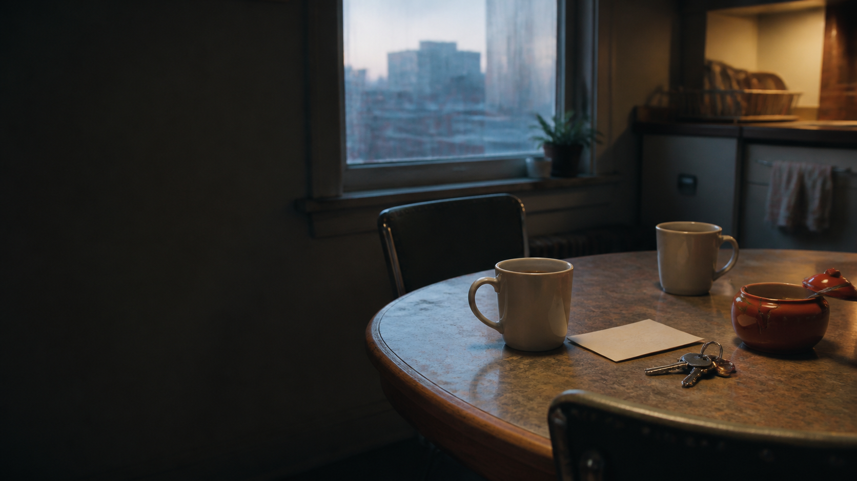
BUNKIES / PRIVATE ENTRY 15
THE PRISTINE WORLD
IS OFFICIALLY DEAD.
THE POLLUTED ERA
HAS BEGUN.
And somehow that feels like home.
BUNKIES
CREATED BY DAN GALEA & NIKKI PAYNE
READ THE PILOT →
SOURCE FOLDER →
15
Notes:
[Sources]
- Original creative source: Bunkies_Series_Pitch.pdf — https://drive.google.com/file/d/1tnmFUXDbfzZtrP_CZwmBUDGFne3sOrVP/view
- Pilot teleplay: BUNKIES.pdf — https://drive.google.com/file/d/1ar46T1E0PMynXS2NCMS-bK2salT2uSoC/view
- Visual: OpenAI-generated dawn coffee still, dawn-coffee.png, created for this deck.
[/Sources]

