Slide 1

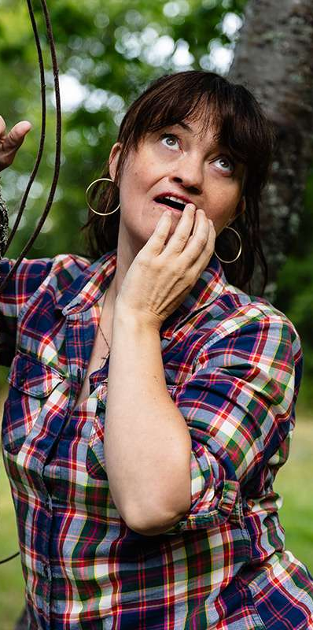

PRIVATE ENTRY 01 / DO NOT LEAVE IN LOBBY
BUNKIES
A promise she can’t break.
A brother she can’t evict.
grief, guilt + the worst roommate alive
CREATED BY DAN GALEA & NIKKI PAYNE
ORIGINAL COMEDY SERIES
ORDER
CHAOS
COME INSIDE →
01
Notes:
[Sources]
- Original creative source: Bunkies_Series_Pitch.pdf — https://drive.google.com/file/d/1tnmFUXDbfzZtrP_CZwmBUDGFne3sOrVP/view
- Pilot teleplay: BUNKIES.pdf — https://drive.google.com/file/d/1ar46T1E0PMynXS2NCMS-bK2salT2uSoC/view
- Character portrait: Nikki Payne.jpg, supplied by the user.
- Character cutout: identity-preserving extraction from Dan Galea.jpeg, supplied by the user.
- Visual: OpenAI-generated mixed-media comedy collage, comedy-collage-bg.png.
[/Sources]

Slide 2
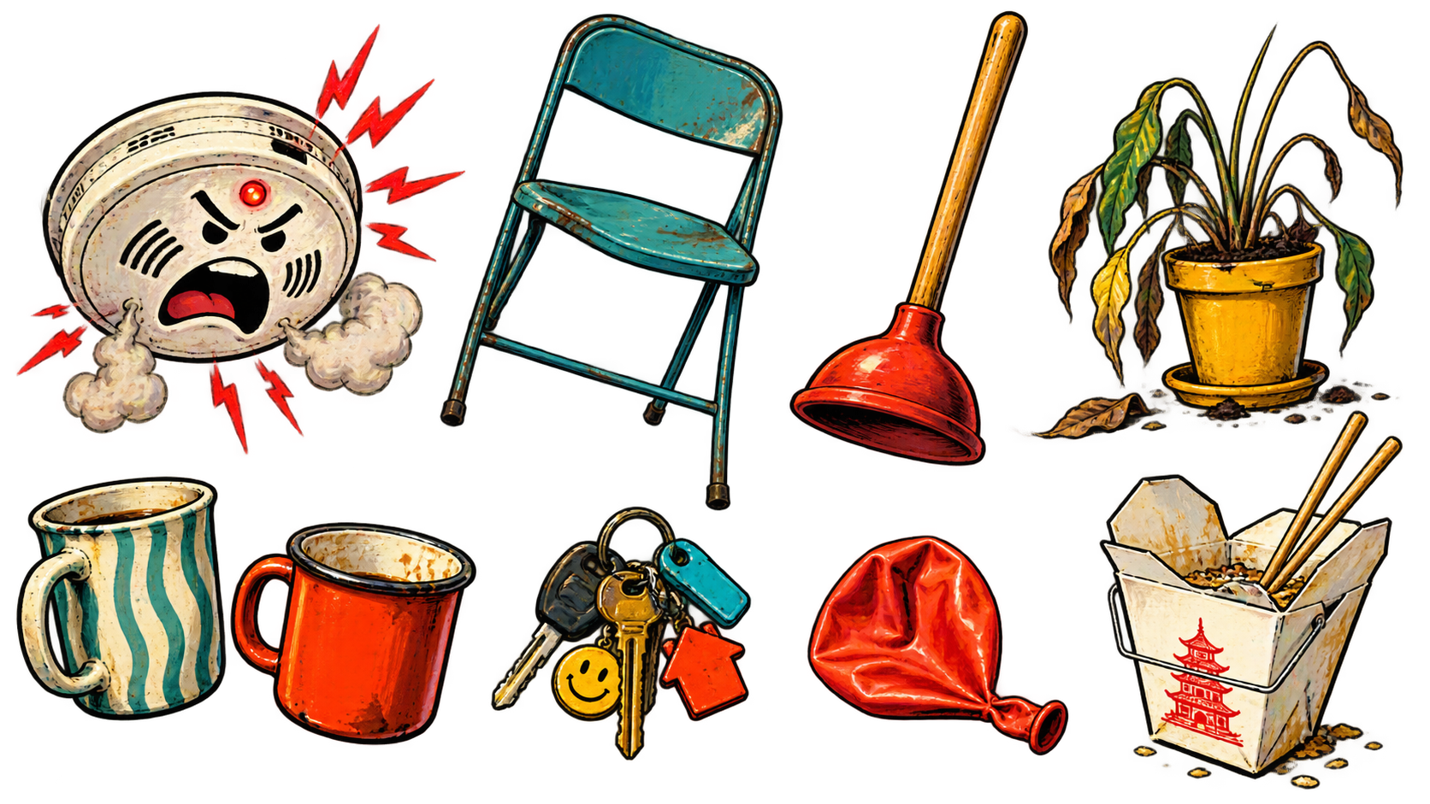
PRIVATE ENTRY 02 / DO NOT LEAVE IN LOBBY
NIKKI PROMISES HER DYING ROOMMATE
SHE’LL LOOK AFTER HIS IDENTICAL TWIN.
DAN HEARS A LEASE.
The face she misses becomes the chaos she can’t escape.
emotionally binding. legally… unclear.
02
Notes:
[Sources]
- Original creative source: Bunkies_Series_Pitch.pdf — https://drive.google.com/file/d/1tnmFUXDbfzZtrP_CZwmBUDGFne3sOrVP/view
- Pilot teleplay: BUNKIES.pdf — https://drive.google.com/file/d/1ar46T1E0PMynXS2NCMS-bK2salT2uSoC/view
- Visual: OpenAI-generated apartment prop sticker sheet, prop-stickers.png.
[/Sources]

Slide 3
PRIVATE ENTRY 03 / DO NOT LEAVE IN LOBBY
ONE LAST REQUEST.
FOUR TERRIBLE CONSEQUENCES.
this is why dying wishes need terms & conditions
01
03
02
04
SUNNY DIES
NIKKI SAYS YES
THE LAST ASK
DAN MOVES IN
Freak mudslide.
Saintly twin gone.
Grief removes
the escape clause.
“Take care of
my brother.”
Compassion becomes
tenancy.
THE SERIES ENGINE IS THE PROMISE SHE CAN’T UNMAKE.
03
Notes:
[Sources]
- Original creative source: Bunkies_Series_Pitch.pdf — https://drive.google.com/file/d/1tnmFUXDbfzZtrP_CZwmBUDGFne3sOrVP/view
- Pilot teleplay: BUNKIES.pdf — https://drive.google.com/file/d/1ar46T1E0PMynXS2NCMS-bK2salT2uSoC/view
[/Sources]

Slide 4
PRIVATE ENTRY 04 / DO NOT LEAVE IN LOBBY
what could go wrong?
ORDER
Her boundaries
are architecture.
+
CHAOS
His are light
suggestions.
04
Notes:
[Sources]
- Original creative source: Bunkies_Series_Pitch.pdf — https://drive.google.com/file/d/1tnmFUXDbfzZtrP_CZwmBUDGFne3sOrVP/view
- Pilot teleplay: BUNKIES.pdf — https://drive.google.com/file/d/1ar46T1E0PMynXS2NCMS-bK2salT2uSoC/view
- Character portrait: Nikki Payne.jpg, supplied by the user.
- Character cutout: identity-preserving extraction from Dan Galea.jpeg, supplied by the user.
[/Sources]

Slide 5
PRIVATE ENTRY 05 / DO NOT LEAVE IN LOBBY
NIKKI
PLAYED BY NIKKI PAYNE
She had a system.
then Dan moved in.
01
Schedules are sacred.
02
Hospitality has rules.
03
Grief is the first thing she can’t organize.
“JUST DON’T BE AN ASSHOLE.”
05
Notes:
[Sources]
- Original creative source: Bunkies_Series_Pitch.pdf — https://drive.google.com/file/d/1tnmFUXDbfzZtrP_CZwmBUDGFne3sOrVP/view
- Pilot teleplay: BUNKIES.pdf — https://drive.google.com/file/d/1ar46T1E0PMynXS2NCMS-bK2salT2uSoC/view
- Character portrait: Nikki Payne.jpg, supplied by the user.
[/Sources]

Slide 6
PRIVATE ENTRY 06 / DO NOT LEAVE IN LOBBY
DAN
somehow still family
PLAYED BY DAN GALEA
THE CONTAMINATION
EVENT.
He treats every boundary like a suggestion—then acts wounded when the furniture disagrees.
SHAMELESS
LOYAL—EVENTUALLY
INVENTIVE
06
Notes:
[Sources]
- Original creative source: Bunkies_Series_Pitch.pdf — https://drive.google.com/file/d/1tnmFUXDbfzZtrP_CZwmBUDGFne3sOrVP/view
- Pilot teleplay: BUNKIES.pdf — https://drive.google.com/file/d/1ar46T1E0PMynXS2NCMS-bK2salT2uSoC/view
- Character cutout: identity-preserving extraction from Dan Galea.jpeg, supplied by the user.
[/Sources]

Slide 7
PRIVATE ENTRY 07 / DO NOT LEAVE IN LOBBY
THE FIGHT IS FUNNY
BECAUSE THE NEED IS REAL.
control is a love language. apparently.
↔
SHE BUILDS RULES
HE FINDS LOOPHOLES
SHE HIDES GRIEF
HE PERFORMS NEED
SHE WANTS CONTROL
HE WANTS BELONGING
07
Notes:
[Sources]
- Original creative source: Bunkies_Series_Pitch.pdf — https://drive.google.com/file/d/1tnmFUXDbfzZtrP_CZwmBUDGFne3sOrVP/view
- Pilot teleplay: BUNKIES.pdf — https://drive.google.com/file/d/1ar46T1E0PMynXS2NCMS-bK2salT2uSoC/view
- Character portrait: Nikki Payne.jpg, supplied by the user.
- Character cutout: identity-preserving extraction from Dan Galea.jpeg, supplied by the user.
[/Sources]

Slide 8

PRIVATE ENTRY 08 / DO NOT LEAVE IN LOBBY
THE APARTMENT IS
THE THIRD LEAD.
ORDER
CHAOS
LOCATION BUDGET: 1 / DISASTER BUDGET: INFINITE
08
Notes:
[Sources]
- Original creative source: Bunkies_Series_Pitch.pdf — https://drive.google.com/file/d/1tnmFUXDbfzZtrP_CZwmBUDGFne3sOrVP/view
- Pilot teleplay: BUNKIES.pdf — https://drive.google.com/file/d/1ar46T1E0PMynXS2NCMS-bK2salT2uSoC/view
- Visual: OpenAI-generated mixed-media apartment order/chaos interior, order-chaos-room.png.
[/Sources]

Slide 9
PRIVATE ENTRY 09 / DO NOT LEAVE IN LOBBY
EVERY EPISODE STARTS CLEAN.
it does not stay that way.
01
NEED
Nikki wants one adult outcome.
02
BOUNDARY
She builds a rule around it.
03
CONTAMINATION
Dan touches the rule.
04
RESCUE
The chaos fixes something bigger.
RESET: THE ROOM SURVIVES. THE RELATIONSHIP GETS HARDER TO UNDO.
09
Notes:
[Sources]
- Original creative source: Bunkies_Series_Pitch.pdf — https://drive.google.com/file/d/1tnmFUXDbfzZtrP_CZwmBUDGFne3sOrVP/view
- Pilot teleplay: BUNKIES.pdf — https://drive.google.com/file/d/1ar46T1E0PMynXS2NCMS-bK2salT2uSoC/view
[/Sources]

Slide 10
PRIVATE ENTRY 10 / DO NOT LEAVE IN LOBBY
28
PAGES OF
CATASTROPHIC PROOF.
01
03
05
02
04
PROMISE
EJECTION
RESET
INVASION
RESCUE
A HARD RESET—WITH ONE DEGREE MORE ATTACHMENT.
READ THE PILOT →
10
Notes:
[Sources]
- Original creative source: Bunkies_Series_Pitch.pdf — https://drive.google.com/file/d/1tnmFUXDbfzZtrP_CZwmBUDGFne3sOrVP/view
- Pilot teleplay: BUNKIES.pdf — https://drive.google.com/file/d/1ar46T1E0PMynXS2NCMS-bK2salT2uSoC/view
[/Sources]

Slide 11
PRIVATE ENTRY 11 / DO NOT LEAVE IN LOBBY
NOBODY CALMS THE ROOM.
they add oxygen.
KATE
THE GROUNDING WIRE
Logic, loyalty and the occasional terrible idea.
JEFF + TRACY
THE ESCALATION UNIT
Private dysfunction becomes a building-wide crisis.
CLARK
THE BIZARRE OUTLIER
A date so wrong that Dan becomes protection.
11
Notes:
[Sources]
- Original creative source: Bunkies_Series_Pitch.pdf — https://drive.google.com/file/d/1tnmFUXDbfzZtrP_CZwmBUDGFne3sOrVP/view
- Pilot teleplay: BUNKIES.pdf — https://drive.google.com/file/d/1ar46T1E0PMynXS2NCMS-bK2salT2uSoC/view
- Visual: OpenAI-generated apartment prop sticker sheet, prop-stickers.png.
[/Sources]

Slide 12
PRIVATE ENTRY 12 / DO NOT LEAVE IN LOBBY
FAST.
MESSY.
TRUE.
The joke lands fast. The room remembers. The heart arrives late.
too far? good. now make it honest.
SINGLE-CAMERA
PERFORMANCE-LED
COMEDY WITH CONSEQUENCES
12
Notes:
[Sources]
- Original creative source: Bunkies_Series_Pitch.pdf — https://drive.google.com/file/d/1tnmFUXDbfzZtrP_CZwmBUDGFne3sOrVP/view
- Pilot teleplay: BUNKIES.pdf — https://drive.google.com/file/d/1ar46T1E0PMynXS2NCMS-bK2salT2uSoC/view
[/Sources]

Slide 13
PRIVATE ENTRY 13 / DO NOT LEAVE IN LOBBY
THE APARTMENT STAYS PUT.
THE DAMAGE TRAVELS.
01
03
05
02
04
HOME
DATING
NEIGHBOURS
WORK
FAMILY
Sovereignty fights
Safety versus control
Private chaos goes public
Improvisation meets order
Sunny keeps rewriting them
FAMILIAR LOCATION. FRESH CONTAMINATION.
13
Notes:
[Sources]
- Original creative source: Bunkies_Series_Pitch.pdf — https://drive.google.com/file/d/1tnmFUXDbfzZtrP_CZwmBUDGFne3sOrVP/view
- Pilot teleplay: BUNKIES.pdf — https://drive.google.com/file/d/1ar46T1E0PMynXS2NCMS-bK2salT2uSoC/view
[/Sources]

Slide 14
PRIVATE ENTRY 14 / DO NOT LEAVE IN LOBBY
ONE APARTMENT.
ENDLESS DAMAGE.
01
REPEATABLE VISUAL SIGNATURE
02
NATURAL A/B STORY COLLISIONS
03
ENSEMBLE WITH LEVERAGE
04
TORONTO WITHOUT THE POSTCARD
PRODUCTION ECONOMY WITHOUT VISUAL SMALLNESS.
14
Notes:
[Sources]
- Original creative source: Bunkies_Series_Pitch.pdf — https://drive.google.com/file/d/1tnmFUXDbfzZtrP_CZwmBUDGFne3sOrVP/view
- Pilot teleplay: BUNKIES.pdf — https://drive.google.com/file/d/1ar46T1E0PMynXS2NCMS-bK2salT2uSoC/view
- Visual: OpenAI-generated mixed-media comedy collage, comedy-collage-bg.png.
[/Sources]

Slide 15
PRIVATE ENTRY 15 / DO NOT LEAVE IN LOBBY
WELCOME TO
THE POLLUTED ERA.
somehow it feels like home
BUNKIES
CREATED BY DAN GALEA & NIKKI PAYNE
READ THE PILOT →
SOURCE FOLDER →
15
Notes:
[Sources]
- Original creative source: Bunkies_Series_Pitch.pdf — https://drive.google.com/file/d/1tnmFUXDbfzZtrP_CZwmBUDGFne3sOrVP/view
- Pilot teleplay: BUNKIES.pdf — https://drive.google.com/file/d/1ar46T1E0PMynXS2NCMS-bK2salT2uSoC/view
- Character portrait: Nikki Payne.jpg, supplied by the user.
- Character cutout: identity-preserving extraction from Dan Galea.jpeg, supplied by the user.
- Visual: OpenAI-generated mixed-media comedy collage, comedy-collage-bg.png.
[/Sources]

